Slide 1
Perception
Chapter 2

Slide 2
Perception
Learning Objectives
What It Means to Perceive
How It Works: The Case of Visual Perception
Building from the Bottom Up: From Features to Objects
Achieving Visual Recognition: Have I Seen You Before?
Interpreting from the Top Down: What You Know Guides What You See
In Models and Brains: The Interactive Nature of Perception
Notes:
What is perception and why is it a difficult ability to understand?
What general principles help us to understand perception?
How do we put together parts to recognize objects and events?
How do we recognize objects and events?
How does our knowledge affect our perception?
Finally, how do our brains put together the many and varied cues we use to perceive?

Slide 3
What’s the Difference?
Sensation
Perception

Slide 4
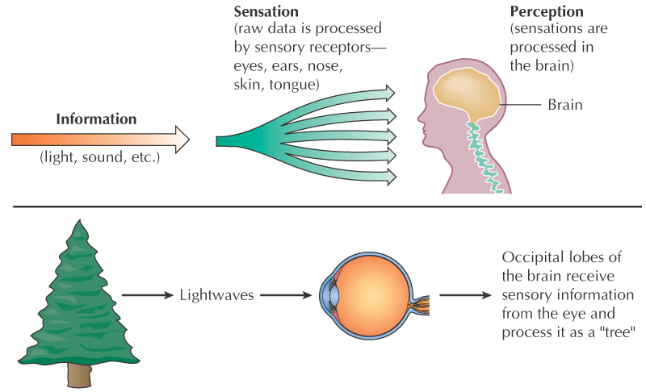
Definitions
Sensation

Slide 5
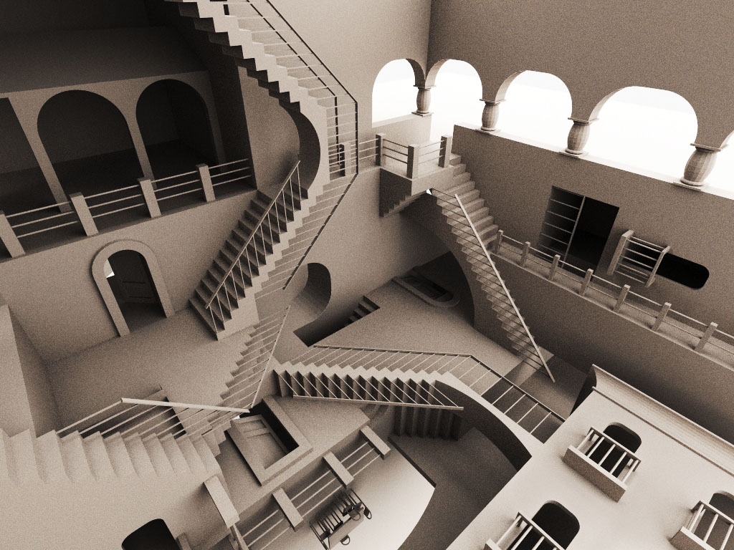
Definitions
Perception
What do I make of it?

Slide 6
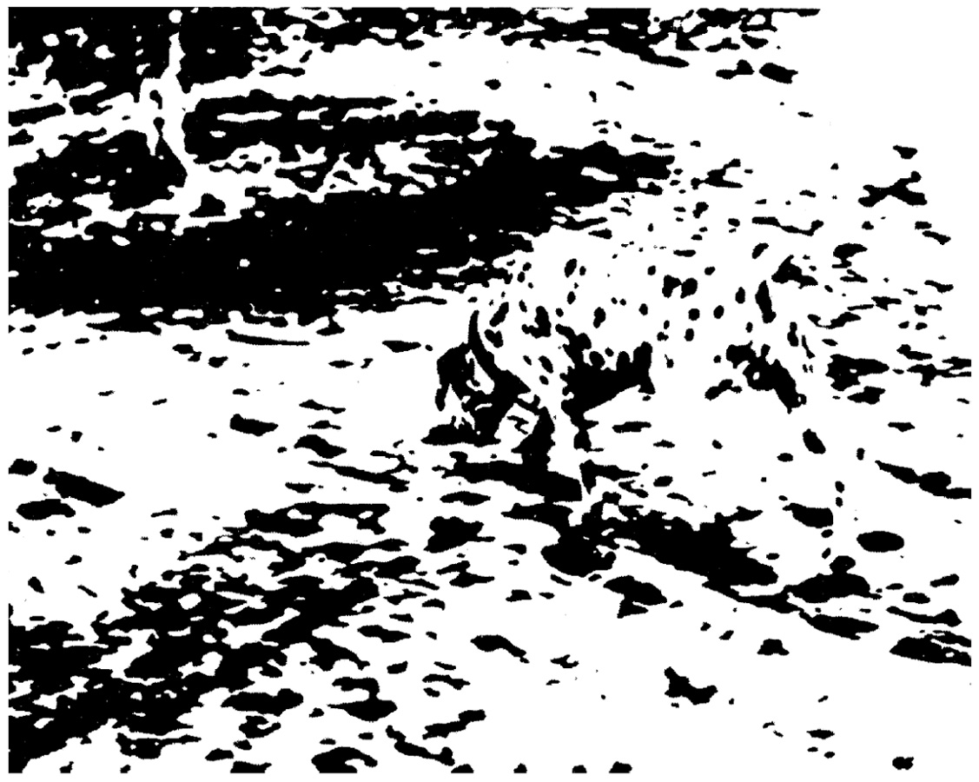
Blobs or pattern of a dog?
Notes:
So basically we are going to be explaining how you can see this as a dog and as blobs.

Slide 7
What’s the difference?
We can get different perceptions from the same sensation.
Sensation has both too much and too little information to explain perception.

Slide 8
Nekker Cube

Slide 9
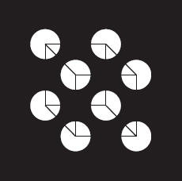
Notes:
What do you see? Probably a cube. Does it seem to be floating in front of a black background with white dots on it? Or, rather to be lying behind a black sheet with holes punched into it? As to the cube itself, is the surface that seems closest to you angled up and to the left or angled down and to the right? Why see a cube at all? The image, of course, is actually flat on the page. You might swear that you can see the lines of the cube crossing the black region, but they are not present in the image. There are only eight carefully positioned white dots, each containing a carefully positioned set of three line segments. Nonetheless we see the cube, even though the im­age doesn’t have all the properties of a real cube, even one drawn on a two-dimensional surface, but only a sparse subset of those properties. We fill in the missing pieces and perceive more than is actually there. So the first problem is that sensory in­put does not contain enough information to explain our perception. When you looked at and interpreted (the above), for example, you had to infer an object from mere hints. (p. 52)

Slide 10
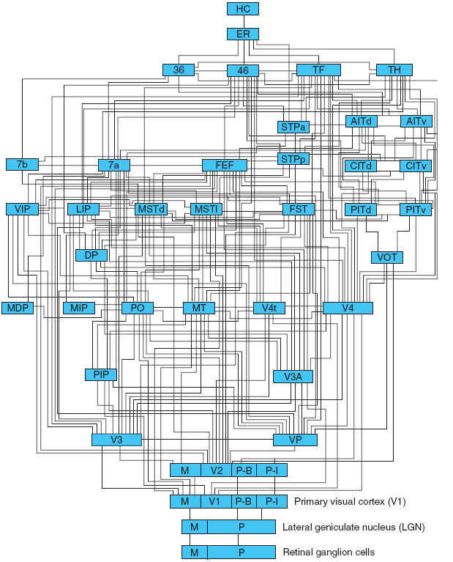
How It Works
Notes:
A “wiring diagram” of the visual system, showing connections among brain areas. Note that there are two types of retinal ganglion cells (magnocellular, abbreviated M, and parvocellular, abbreviated P); these cells project axons to different portions of areas V1 and V2.)
(Felleman, D. J. & Van Essen, D. C. (1991). Distributed hierarchical processing in the primate cerebral cortex. Cere­bral Cortex, 1, 1—47 (Fig. 4 on p. 30). Reprinted with permission of Oxford University Press.) (p. 56)

Slide 11
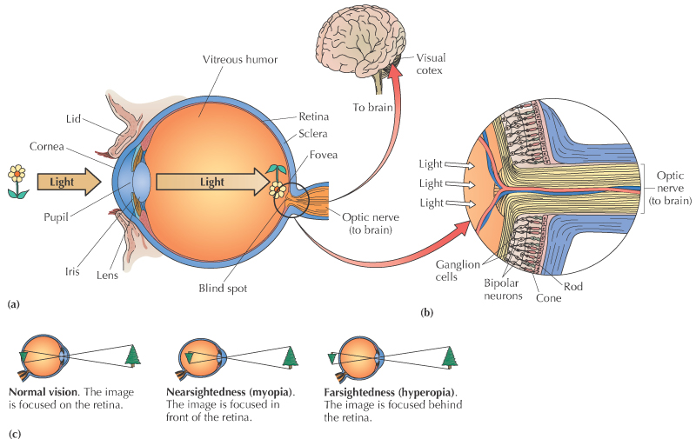
How It Works

Slide 12
How It Works
Cornea
Helps gather and direct incoming light
Iris
The muscle that controls the size of the pupil
Pupil
Changes in size to let in different amounts of light

Slide 13
How It Works
Lens
Actively focuses, or bends, light as it enters the eye
Retina
Contains sensory receptors for vision (rods and cones)

Slide 14
How It Works
Cones
Hooray Color
Sharpness
Rods
We like the light (night vision, dark adaptation).
And the sides (peripheral).

Slide 15
How It Works
Fovea
Only cones
Periscope of sharp vision

Slide 16
How It Works
Optic Nerve
The thick nerve that exits from the back of the eye
Carries visual information to the visual cortex and brain
Blind Spot
The point at which the optic nerve leaves the eye, producing a small gap in the field of vision

Slide 17
The Structure of the Visual System
Beyond the primary visual cortex, two main pathways can be identified:
(1) A dorsal pathway reaches up into the parietal lobes and is important in processing information about where items are located and how they might be acted on, guiding movements such as grasping.
(2) A ventral pathway reaches down into the temporal lobes; this pathway processes information that leads to the recognition and identification of objects.

Slide 18
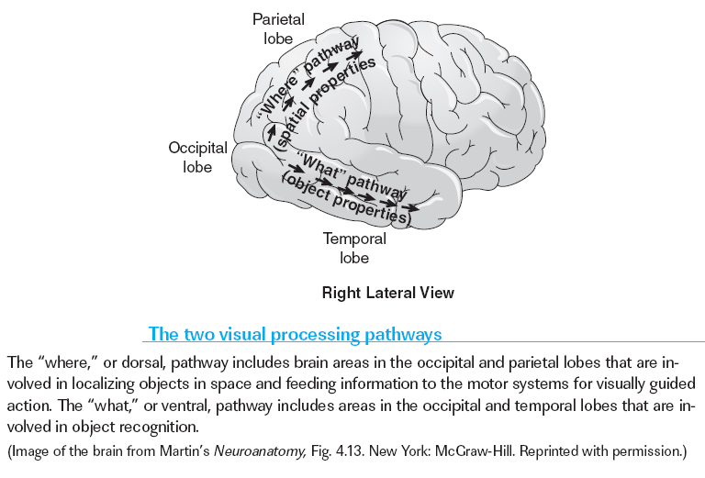
Seeing the “What” and the “Where”

Slide 19
How It Works
Something cool:
Renitopic mapping
Notes:
So if your eye has a movie screen in the back of it, when it sends it down the dorsal pathway, it puts it in that brain system as if It were still on the movie screen

Slide 20
How It Works
Bottom up processing - driven by sensory info
Top down processing - controlled by context info
Notes:
And this is where we are going - explaining each in depth

Slide 21
Spots and Edges
Each ganglion cell is connected, through a series of other cells, to a collection of photoreceptors that are neighbors to each other.
This means that the ganglion cell will respond only to light that lands on those receptors and, thus, to light in one specific region in the visual field, the portion of the world that is visible at the present moment.
Our ganglion cell gets input from the receptors that lie in its receptors that lie in its receptive field, the region shown in color at the bottom of the figure.
In vision, the receptive field of a cell is the area of the visual field in which a stimulus will affect the activity of the cell.

Slide 22
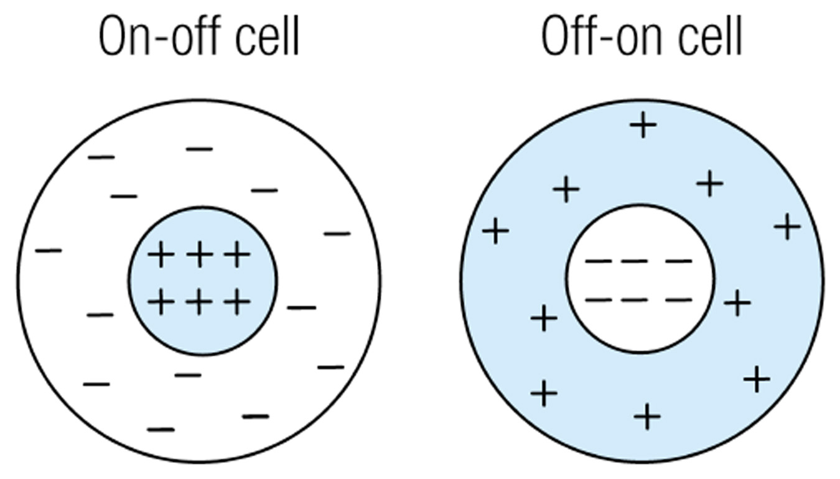
On-off and off-on receptive fields.

Slide 23
Bottom Up
Edge detectors
Respond positively to light on one side of a line and negatively to light on the other side
Bar detectors
Respond positively to light in the center and negatively to light at the periphery, or vice versa

Slide 24
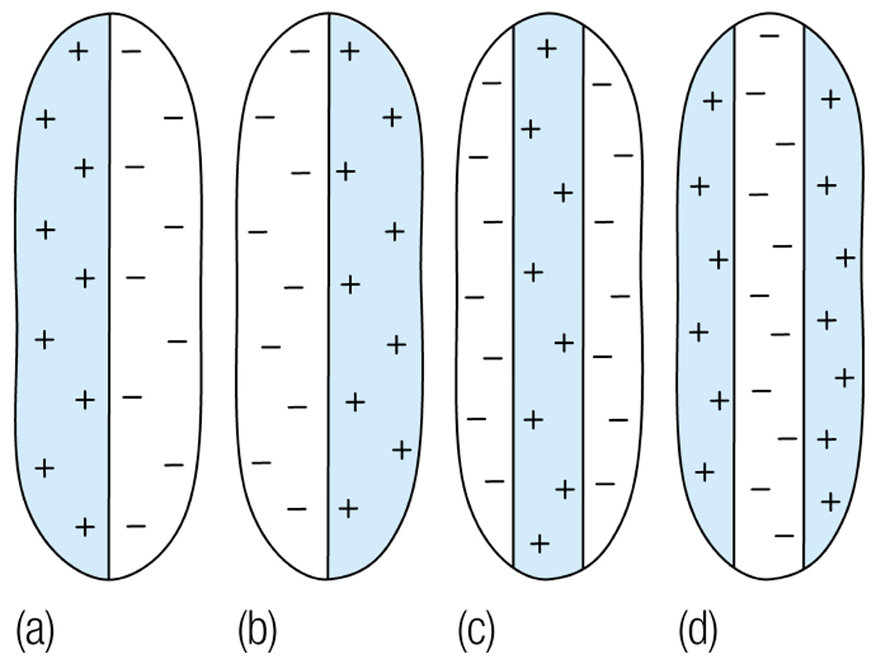
Response patterns of cells in the visual cortex.

Slide 25

Spots and Edges
Six uniform rectangles are shown abutting one another, ordered from lightest to darkest. Even though the level of gray in each rectangle is uniform, it looks as if each one is a bit lighter on its right edge than its left edge and darker on its left edge. These edge effects come from the neighboring rectan­gle, and are predicted from the responses of ganglion cell neurons

Slide 26
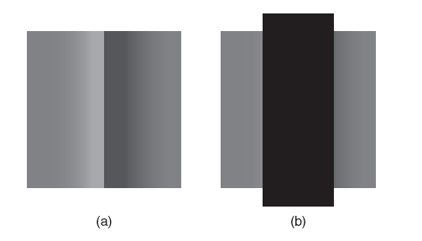
Throwing Away Information
The Craik-Cornsweet-O’Brien illusion (a) A gray rectangle is shown with a special edge in the middle. The rectangle seems to be divided with a lighter region on the left and darker region on the right. If you look closely, you will see that actually the two regions are not uniform. There is a gradual transition in each side, producing a sharp change from light to dark in the middle. (b) This is the same figure as in (a), but with the middle region covered by a black rectangle. Now you can see that the gray regions are actually the same. Try putting your finger over the middle of (a) to reveal the illusion.
Notes:
The visual system seems to be designed to collect information about features, such as spots and edges, and not to spend unnecessary energy on nearly uniform areas where nothing much is happening. This bias is demonstrated by the Craik–O’Brien–Cornsweet illusion (Cornsweet, 1970; Craik, 1940; O’Brien, 1958) (p. 62)
The human visual system processes its input in great detail, but not in every part of the visual field. Here again information is thrown away. (p. 62)

Slide 27
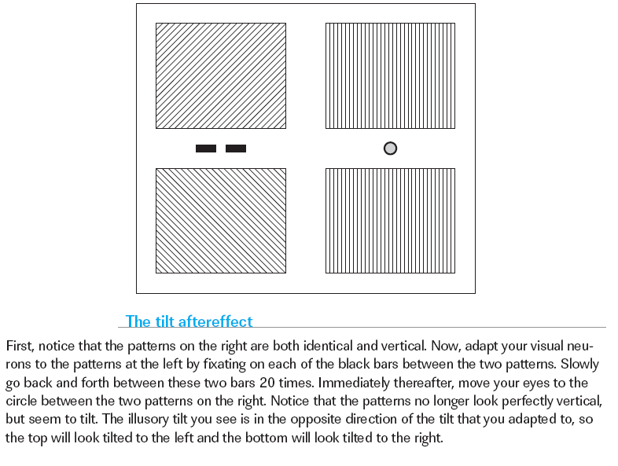

Slide 28
Neural Processing of Features
Tilt aftereffect: What would normally produce equal activity in the left-and the right-sensing neurons, produces more activity in the left-sensing neurons because the right-sensing ones have been fatigued.
In akinetopsia, or motion blindness—the loss of the ability to see objects move. Those affected report that they perceive a collection of still images.
In achromatopsia, or cortical color blindness all color vision is lost and the world appears in shades of gray. And in achromatopsia, unlike as in blindness caused by damage to the eyes or optic nerve, even memory of color is gone.

